Slide 1


EPIGENOMICS EXAM PRESENTATION: ChIP-Seq experiment on the TF SOX6 Roberto Amarie ID:11297A
Master of Science in Bioinformatics for Computational Genomics

Slide 2

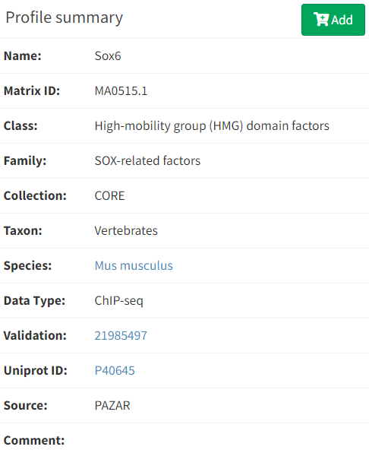
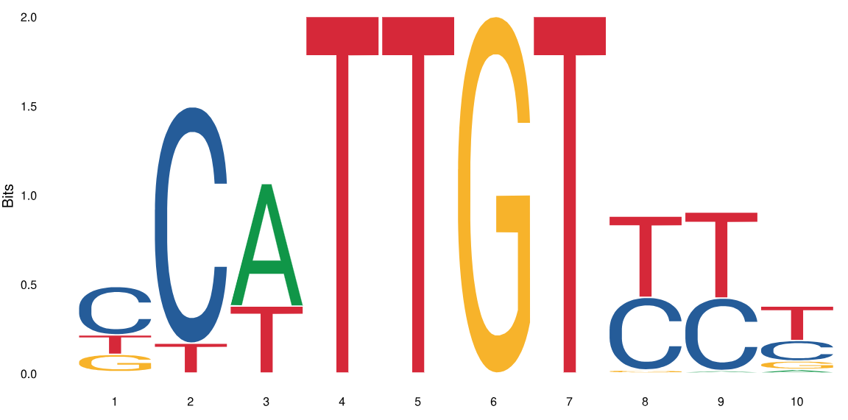


Background info on Sox6
SOX FAMILY FUNCTION:
regulation of several different aspects of development: many Sox genes are involved in sex determination, some are important in other processes such as neuronal development
SOX6 FUNCTION:
crucial role in the transcriptional regulation of globin genes, and in directing the terminal differentiation of red blood cells as well as for required for proper formation of nervous system, cartilage and cardiac and skeletal muscle
Notes:
-------------------------------------------------------------------------------------------------------------------
--------------------------------------------------SOX FAMILY--------------------------------------------------
-------------------------------------------------------------------------------------------------------------------
The SOX gene family encodes a group of transcription factors defined by the conserved high mobility group (HMG) DNA-binding domain. Unlike most transcription factors, SOX transcription factors bind to the minor groove of DNA, causing a 70- to 85-degree bend and introducing local conformational changes.
HMG-box containing proteins only bind non-B-type DNA conformations (kinked or unwound) with high affinity.^{[1]} HMG-box domains are found in some high mobility group proteins, which are involved in the regulation of DNA-dependent processes such as transcription, replication, and DNA repair, all of which require changing the conformation of chromatin.^{[3]} The single and the double box HMG proteins alter DNA architecture by inducing bends upon binding.
A-DNA and Z-DNA differ significantly in their geometry and dimensions to B-DNA, although still form helical structures. It was long thought that the A form only occurs in dehydrated samples of DNA in the laboratory, such as those used in crystallographic experiments, and in hybrid pairings of DNA and RNA strands, but DNA dehydration does occur in vivo, and A-DNA is now known to have biological functions. Segments of DNA that cells have methylated for regulatory purposes may adopt the Z geometry, in which the strands turn about the helical axis the opposite way to A-DNA and B-DNA. There is also evidence of protein-DNA complexes forming Z-DNA structures.
A-DNA can be derived from a few processes, including dehydration and protein binding. Dehydration of DNA drives it into the A form, which has been shown to protect DNA under conditions such as the extreme desiccation of bacteria.^{[5][1]} Protein binding can also strip solvent off of DNA and convert it to the A form, as revealed by the structure of several hyperthermophilic archaeal viruses.
SOX = SRY-related HMG-box genes
Sox genes are defined as containing the HMG box of a gene involved in sex determination called SRY, which resides on the Y-chromosome
Almost all Sox genes show at least 50% amino acid similarity with the HMG box in Sry.
The developmentally important Sox family has no singular function, and many members possess the ability to regulate several different aspects of development. While many Sox genes are involved in sex determination, some are important in other processes such as neuronal development
Sox proteins bind to the sequence WWCAAW and similar sequences (W=A or T). They have weak binding specificity and unusually low affinity for DNA. Sox genes are related to the Tcf/Lef1 group of genes which also contain a sequence-specific high mobility group and have a similar sequence specificity (roughly TWWCAAAG)
Molecular interactions with other transcriptional regulators are crucial for each SOX factor to recognize a specific target gene, as each protein of this family is expressed in many different cellular contexts and a specific cell type can co-express many SOX factors (Wegner 1999). SOX proteins can form stable transcription factor complexes with a variety of co-regulators to activate or repress gene transcription by modulating promoter activity.
It is currently thought that the HMG domain itself not only plays a crucial role in the DNA-binding of SOX factors, but also in their interaction with other transcriptional co-regulators and in nuclear import (Wilson and Koopman 2002). However, as HMG domains are interchangeable between SOX factors (Bergstrom et al. 2000), other parts of the protein outside the HMG domain are likely to play a major role in selecting specific protein partners and generate cell- and developmental stage-specific functions for SOX transcription factors
subgrouped into 10 distinct families (A-J), not only based on homology within the HMG domain and other structural motifs, but also on functional properties
-------------------------------------------------------------------------------------------------------------------
------------------------------------------------------SOX6 ------------------------------------------------------
-------------------------------------------------------------------------------------------------------------------
SoxD (Sox5, L-Sox5, Sox6, Sox13)
Members of this group possess an HMG domain, but are missing transactivation domains, suggesting roles in structural organization in gene expression. Sox5 and Sox6 are essential for neuronal and chondrocyte development, while Sox6 is also an important enhancer of erythropoiesis (Dumitriu et al. 2008). Sox5 was recently found to prevent the premature development of later-born neurons, and thus regulates the timing of neocortical neuronal subtypes (Lai et al. 2008). Sox5 promotes cell proliferation by repressing the expression of SPARC (Huang et al. 2008), a protein believed to be a tumor suppressor. In chondroblast differentiation, Sox5 and Sox6 promote the development of a proliferating pool of chondroblasts, and act by downregulating Indian hedgehog signaling, and the expression of FGFR3 and Runx2 (Smits et al. 2004).
In neural crest development, Sox5 is expressed in early neural crest cells and continues to be expressed in melanocytes, but its loss does not affect melanoblast generation. However, the loss of Sox5 rescues melanoblast generation in Sox10-reduced mice. Sox5 binds to, and represses melanocytic target genes of Sox10, such as Mitf and Dct (Stolt et al. 2008). Sox5 alone did not modulate these genes directly, but did so only in the presence of Sox10 (see below, SoxE proteins). While competition for the same DNA binding site is possible, it appears more likely that in situations with multiple Sox recognition sites, the recruitment of co-repressors, C-terminal binding protein 2 (CtBP2) and HDAC1 to the promoters of Mitf and Dct genes could be more effective. Sox5 does not function exclusively as a co-repressor, but also recruits co-activators to Sox9 target genes in chondrocytes (Hattori et al. 2008).
Sox6 promotes cardiomyocyte differentiation, an event associated with the downregulation of an L-type Ca2+ alpha1c gene. There are eight consensus Sox recognition sites in 1.6kb of the Ca2+ alpha1c promoter, and overexpression of Sox6 suppresses reporter expression in constructs bearing this promoter region (Cohen-Barak et al. 2003). Prtb (proline-rich transcript of the brain), which interacts with Sox6, represses the activity of the alpha1c gene promoter alone, as does Sox6 alone, but interestingly, repression of reporter expression is abolished by co-expression of Prtb with Sox6 (Cohen-Barak et al. 2003). This suggests that Prtb and Sox6 antagonize each other as repressors. Skeletal muscle development consists of two successive waves of myogenesis, embryonic and fetal, generating slow and fast fibers respectively. Sox6 mutant mice show increased slow fiber type-specific gene expression and reduced fast fiber gene expression (Hagiwara et al. 2005). Sox6 has been demonstrated to repress the transcription of slow fiber type-specific genes typified by the Myosin heavy chain-beta (MyHCβ), slow isoform (Hagiwara et al. 2007).
During erythropoiesis, definite erythroid cells in the fetal liver express adult beta globins while the epsilon gene is silenced. Sox6 represses embryonic epsilon gene expression by directly binding its promoter (Yi et al. 2006). Sox6 has been shown to silence other targets in various systems: i) the Fgf-3 promoter through the recruitment of a corepressor, CtBP2 (Murakami et al. 2001), ii) the insulin II gene by serving as an interacting co-repressor of the homeobox factor PDX1 (Iguchi et al. 2005), and iii) the cyclin D1 promoter by interacting with beta-catenin and histone deacetylase (Iguchi et al. 2007).
A new role of Sox6 in renin and prorenin regulation was studied using a Sox KO mouse model in which Sox6 is only knockout in renin expressing cells. This study showed that renin promoter possesses the binding site for Sox6. The highlight of the study was that Sox6 is one of the key regulators of renin and prorenin regulation and JG cell expansion during low salt and dehydration in mice. PMID: 31760770; DOI: 10.1152/ajprenal.00095.2019
Within this general frame, Sox6 has been suggested to act both as activator or repressor, depending on its interactions and on its target sequences (1–3). The Sox domain recognizes a very degenerate (A/T)(A/T)CAA(A/T)G consensus, making it very difficult to identify its in vivo targets: the best-characterized and validated Sox6 target sequence on the regulatory elements of the chondrocyte gene Col2a1 is, for example, composed of four sites each having different mismatches relative to the HMG box consensus (4). Moreover, the presence of adjacent pairs of Sox sites on different known targets suggests that double Sox sites might likely be the preferred Sox6 targets, although the relative arrangement and orientation of the two sites is not yet clearly defined (1–3 and references therein).
Murine Sox6 null mutants (p100H) show delayed growth, myopathy, arterioventricular heart block and die within 2 weeks following birth (5). Sox6 is indeed required for proper formation of heart, nervous system (5,6,7), cartilage (4,8) and cardiac and skeletal muscle (9,10). Recent reports indicate that complete Sox6 ablation causes a perturbation of erythropoiesis resulting in the presence of increased numbers of nucleated and misshaped red cells in the fetal circulation and in a strong relative increase of embryonic (εy) globin gene expression (11–13). In particular, Sox6 directly silences εy-globin expression in murine definitive erythropoiesis by binding to a double Sox6 site lying within a 36-bp region on the εy proximal promoter (13). Moreover, embryonic liver stem cells from Sox6 null mice engrafted into lethally irradiated wild-type (WT) adult mice, show levels of εy expression in the spleen and bone marrow that are higher than those observed in control mice transplanted with wild type cells (12). Finally, Sox6 cooperates with BCL11a to downregulate the γ-globin gene in adult erythroid cells (14).
Sox6 appears to have a crucial role in the transcriptional regulation of globin genes, and in directing the terminal differentiation of red blood cells.^{[10]} In addition, SOX6 may have a role in tumor growth of Ewing sarcoma
It has also been demonstrated that SOX6 protein accumulates in the differentiating human erythrocytes, and then is able to downregulate its own transcription, by directly binding to an evolutionarily conserved consensus sequences located near SOX6 transcriptional start site.
(PROOF of autoregulation https://www.ncbi.nlm.nih.gov/pmc/articles/PMC3025548/)

Slide 3
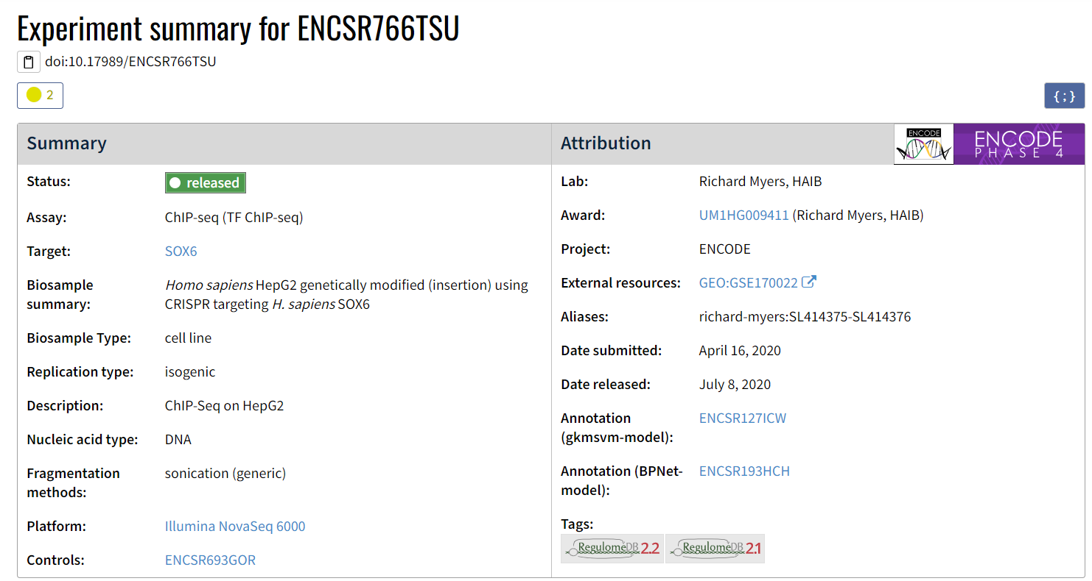
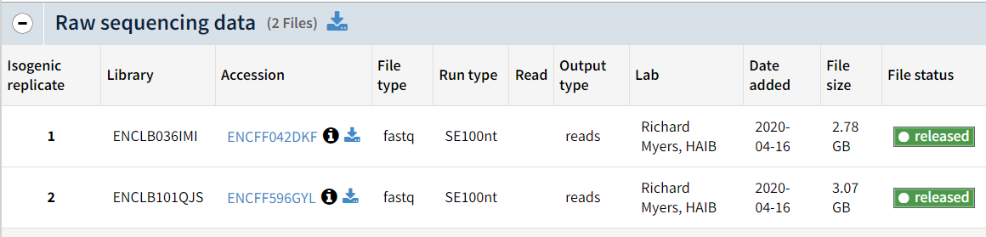
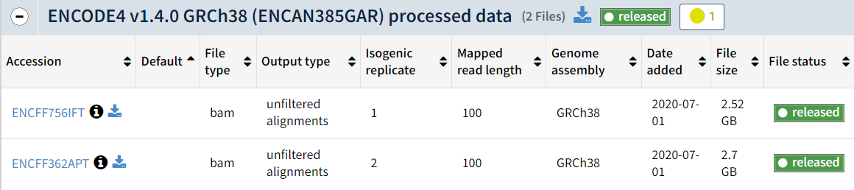
The data
Non downsampled
Single ended sequencing
Notes:
Control NOT downsampled
Single end sequencing

Slide 4
Mapping QC
 | Rep1 | Rep2 | Control
N° initial unfiltered reads | 56 331 194 | 62 509 030 | 51 384 668
N° final reads | 50 604 151 | 54 820 921 | 38 322 580
% mapped reads | 92.78% | 90.40% | 82.34%
% uniquely mapping reads | 89.83% | 87.7% | 74.58%
Notes:
at least 70-75% of your reads should map uniquely
if not, it's just an indicator that a relevant fraction of your sites are on the repetitive regions and you will not consider them, but this should not stop you to act

Slide 5
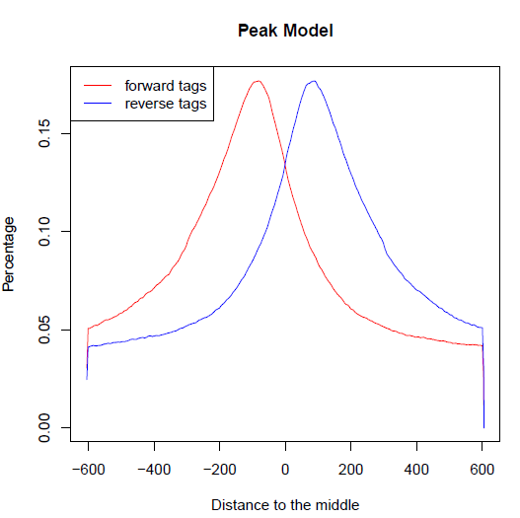
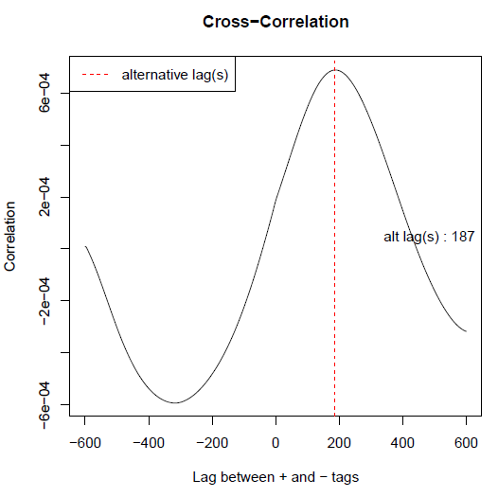
MACS2 Peak calling QC
0.01 q-value threshold used
Scaling up control reads
 | Rep1 peaks | Rep2 peaks | Merged peaks
Redundant rate | 0.11 | 0.15 | 0.15
Estimated fragment size | 181 | 191 | 187
Merged peaks plots
Notes:
Scaling = to account for different library sizes between replicates and control
Redundant rate in the control = 0.16
REP1
# Redundant rate in treatment: 0.11 #should be <20% OK
# Redundant rate in control: 0.16
# d = 181 #should be 100<d<200
REP2
# Redundant rate in treatment: 0.15
# Redundant rate in control: 0.16
# d = 191

Slide 6
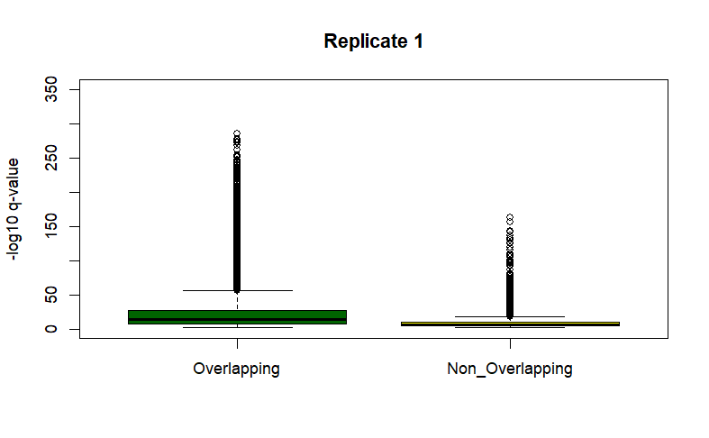
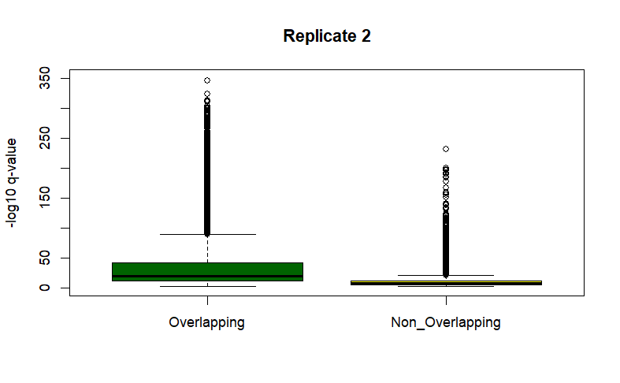
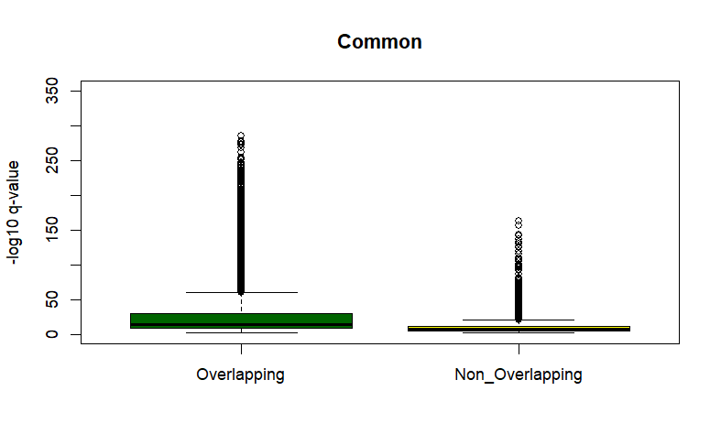
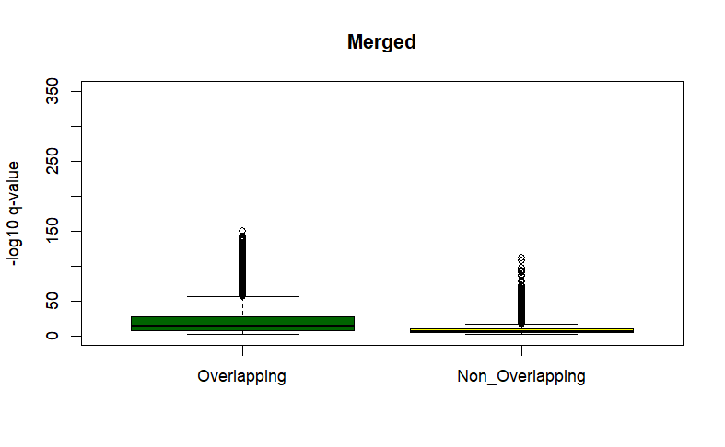

Choosing the best set of peaks
 | Rep1 | Rep2 | Common | Merged
N° peaks (before BLACKLIST removal) | 39056 | 52733 | 31434 | 42763
N° peaks in common with ENCODE results | 27795 | 34264 | 25176 | 31480
Jaccard Index | 0.341941 | 0.418229 | 0.307338 | 0.387226
Notes:
The common are 80% of rep1: >70% so ok
REP1
intersection union-intersection jaccard n_intersections
10645946 31133848 0.341941 30872
REP2
intersection union-intersection jaccard n_intersections
14844142 35492873 0.418229 37663
COMMON
intersection union-intersection jaccard n_intersections
9186032 29888988 0.307338 26635
MERGED
intersection union-intersection jaccard n_intersections
12411299 32051822 0.387226 34070

Slide 7
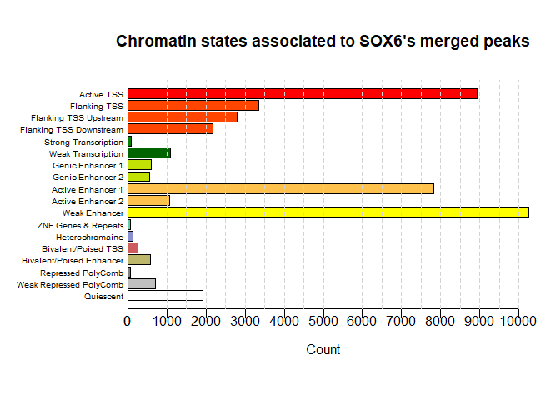
Notes:
Determine the chromatin state associated with each summit by intersecting them with the segmentation annotation (chromMM)
Graphical representation of the major chromatin state categories

Slide 8

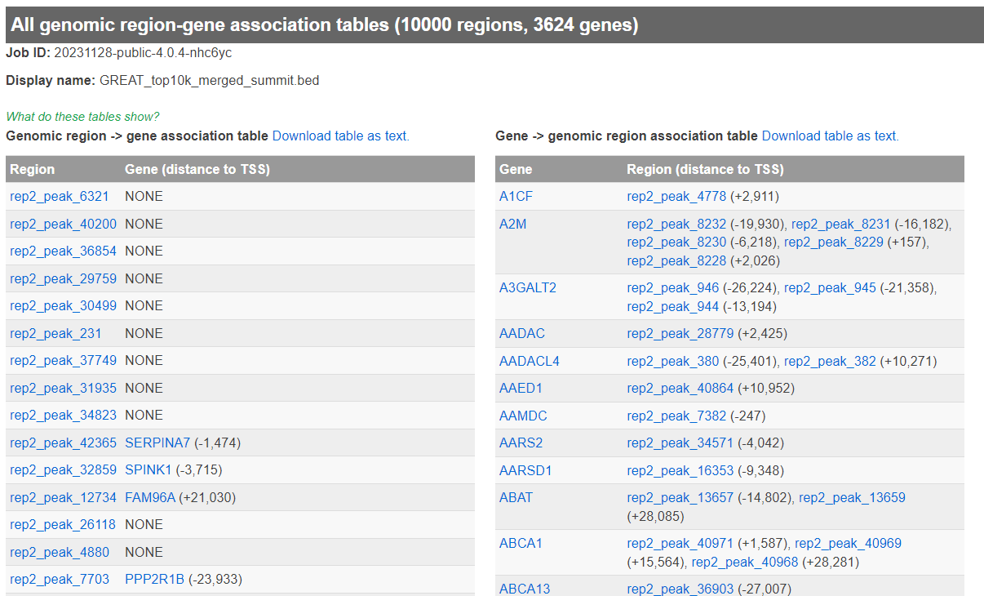
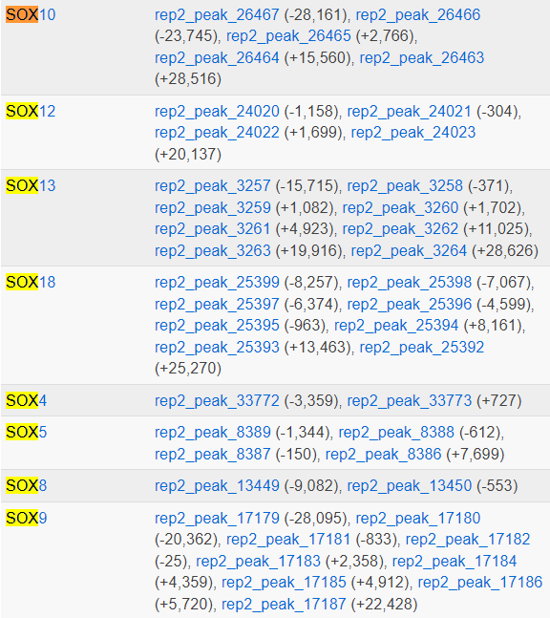
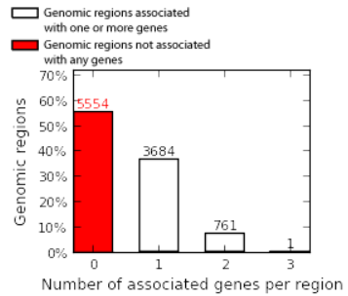
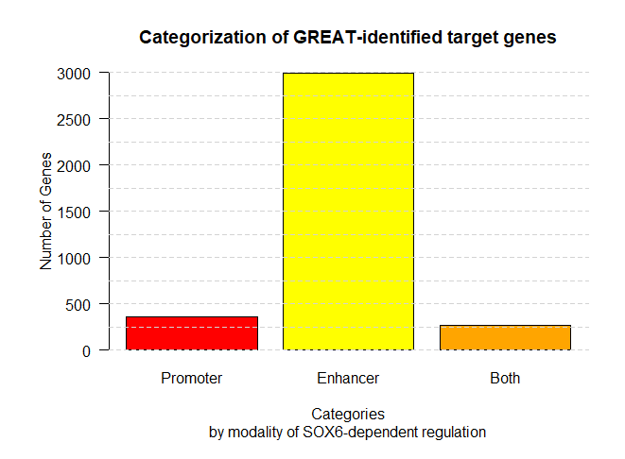
GREAT
All peaks (42763 regions) → 12349 genes associated
Top10k (10000 regions) → 3624 genes associated
No signs of autoregulation of SOX6 by applying the nearest neighbor rule
Notes:
Nearest neighbour rule to find associated genes:
– “Promoter”: +/- 1 kb around the TSS
– “Distal region”: 30 kb from the TSS
– if TSS of the closest gene within +/- 1 kb around the peak , the gene Is associated to it and is regulated by the peak as a promoter
Using all the peaks, SOX6 does not appear to target itself based on the GREAT analysis.
Among it’s orthologs, SOX18 is the first one to show up, but not really at the top of the list; while the others appear with the following order in the significantly ranked list of peak regions:
18>5>9>8>>13>12>10>4
TRY TO SEE IF I CAN DO THE STRIPED BAR FOR THE BOTH CATEGORY IN THIS WAY:
# Install and load ggplot2 if not already installed
# install.packages("ggplot2")
library(ggplot2)
# Sample data
data <- list(
group1 = rnorm(50, mean = 0, sd = 1),
group2 = rnorm(50, mean = 2, sd = 1),
both_conditions = rnorm(50, mean = 1, sd = 1) # Sample data for both conditions
)
# Create a data frame for ggplot
df <- data.frame(
condition = rep(c("Group 1", "Group 2", "Both Conditions"), each = 50),
values = c(data$group1, data$group2, data$both_conditions)
)
# Set up ggplot with custom fill patterns
ggplot(df, aes(x = condition, y = values, fill = condition)) +
geom_boxplot(pattern = c(22, 0), # Use a hatched pattern for the "Both Conditions" box
color = "black",
width = 0.7,
position = position_dodge(0.8)) + # Adjust the position for better separation
scale_fill_manual(values = c("red", "yellow", "white"), # Define fill colors
name = "Conditions") +
labs(title = "Boxplot with Both Conditions",
x = "Conditions",
y = "Values") +
theme_minimal()

Slide 9
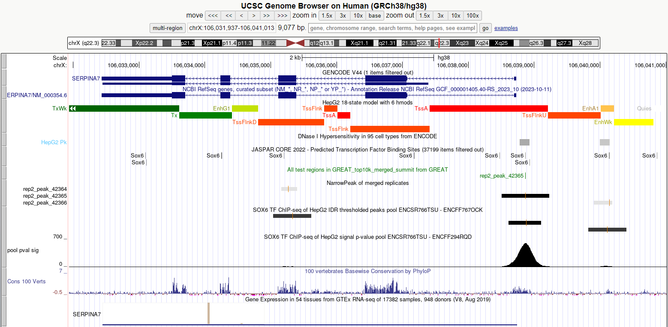

UCSC GB visualization of peak found by both
Notes:
SERPINA 7

Slide 10
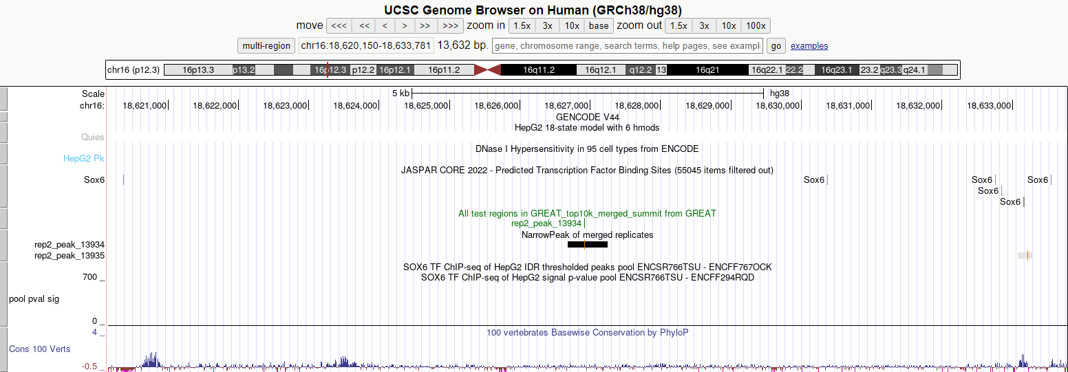
Only by me
Notes:
GENELESS QUIESCENT STATE NON ACCESSIBLE NOSIGPVAL Closish-to-Jaspar
7. signalValue - Measurement of overall (usually, average) enrichment for the region.
9. qValue - Measurement of statistical significance using false discovery rate (-log10). Use -1 if no qValue is assigned
BCG2023_ramarie@leon:~/epigenomics/SOX6$ bedtools intersect -v -a merged_peaks.narrowPeak -b ENCODE_peaks.narrowPeak | sort -k7,7nr | head
chr1 121280738 121281378 rep2_peak_2253 1068 . 21.9813 112.256 106.859 307 SRGAP2C - no anno – no acc – nopvalsig - YesJasp
chr1_KI270712v1_random 163246 163948 rep2_peak_20255 665 . 20.4404 70.681 66.5333 440
chr16 18626685 18627246 rep2_peak_13934 1114 . 19.7068 117.071 111.48 232 geneless – Quies - no acc – nopvalsig - NearishJasp
chr12 112926368 112926932 rep2_peak_9577 612 . 18.3481 65.2579 61.2322 230 OAS1 isoform – Tx – accessible – no pvalsig - NoJasp
chr7 75229511 75230094 rep2_peak_37174 582 . 18.2845 62.2101 58.2538 228 Tfpseudogene/unknown unannotated – quies – no acc - nopvalsig
chr21 43440864 43441519 rep2_peak_25756 665 . 18.2214 70.7189 66.5684 303 geneless – EnhA1 – no acc – nopvalsig -NoJasp
chr5 181298081 181298677 rep2_peak_33317 619 . 16.2823 65.9456 61.9083 338 geneless – Quies – no acc – nopvalsig - YesJasp
chr1 149582170 149582573 rep2_peak_2401 560 . 16.097 59.9208 56.0153 209 geneless – Quies – no acc – nopvalsig - NoJasp
chr22_KI270731v1_random 106597 107038 rep2_peak_26808 662 . 15.9603 70.4006 66.2594 243
chrX 153070045 153070627 rep2_peak_42667 649 . 15.7415 69.1023 64.9898 250 geneless – Quies – no acc – nopvalsig - YesJasp
BCG2023_ramarie@leon:~/epigenomics/SOX6$ bedtools intersect -v -a merged_peaks.narrowPeak -b ENCODE_peaks.narrowPeak | sort -k9,9nr | head
chr16 18626685 18627246 rep2_peak_13934 1114 . 19.7068 117.071 111.48 232 geneless – Quies – no acc - nopvalsig
chr1 121280738 121281378 rep2_peak_2253 1068 . 21.9813 112.256 106.859 307
chr16 16731756 16732465 rep2_peak_13913 966 . 15.221 101.666 96.6547 503 geneless – Quies – no acc – nopvalsig - NearishJasp
chr2 86921627 86922215 rep2_peak_21839 966 . 15.1311 101.666 96.6547 293 RGPD1 – Quies – no acc – nopvalsig - YesJasp
chr7 75235078 75236619 rep2_peak_37175 911 . 14.3365 95.9876 91.1607 747
chr7 74965797 74967321 rep2_peak_37165 902 . 13.4499 95.0792 90.2778 763 CASTOR2 - – Quies – no acc – nopvalsig - YesJasp
chr2 87981210 87981770 rep2_peak_21859 845 . 12.8908 89.2158 84.5858 298 geneless – Quies – no acc – nopvalsig - YesJasp
chr1 206299027 206299806 rep2_peak_3332 770 . 11.4579 81.4951 77.0811 492 SRGAP2 - no anno – no DNAse1acc – nopvalsig - YesJasp
chr2 86911875 86912552 rep2_peak_21838 722 . 9.87775 76.5215 72.235 315 geneless – Quies – no acc – nopvalsig - YesJasp
chr19 53503520 53504274 rep2_peak_20110 717 . 10.9907 76.0187 71.7439 312 geneless – TxWk – no acc – nopvalsig - YesJasp

Slide 11
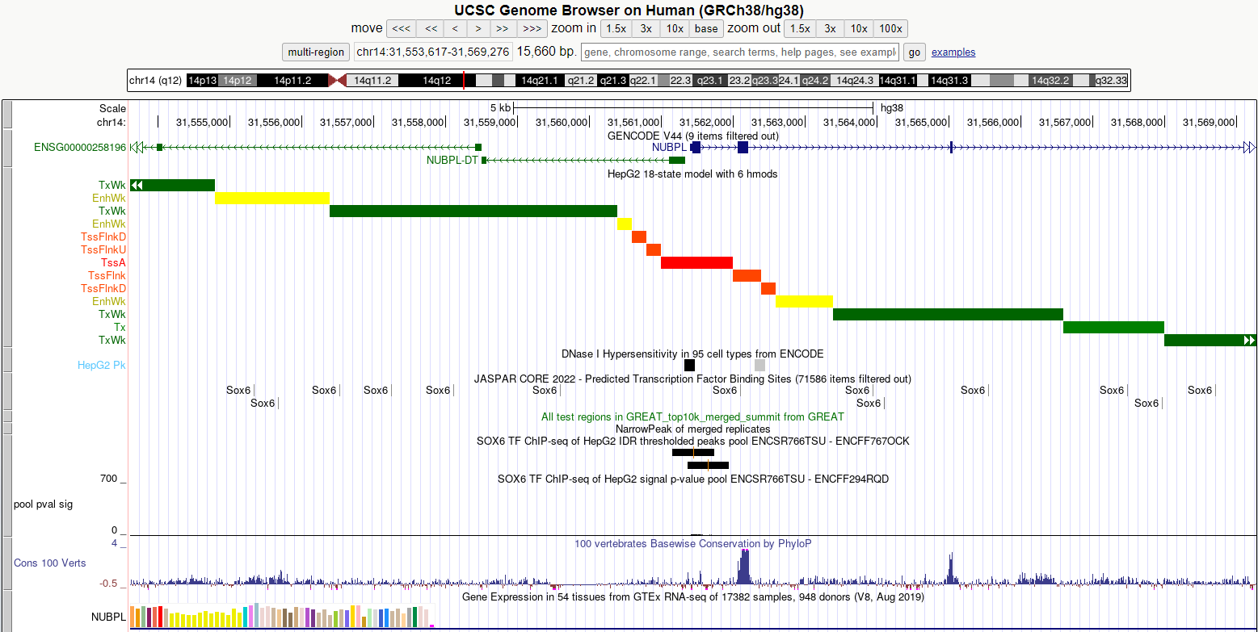
Only by ENCODE
Notes:
7. signalValue - Measurement of overall (usually, average) enrichment for the region.
9. qValue - Measurement of statistical significance using false discovery rate (-log10). Use -1 if no qValue is assigned
BCG2023_ramarie@leon:~/epigenomics/SOX6$ bedtools intersect -v -a ENCODE_peaks.narrowPeak -b merged_peaks.narrowPeak | sort -k7,7nr | head
chr17 81860802 81861382 . 1000 . 175.66937 -1.00000 4.75422 290 P4HB – TssA - acc – smallpvalsig - NoJasp
chr14 31561156 31561736 . 1000 . 174.50381 -1.00000 4.75422 290 NUBPL – TssA - acc – smallpvalsig – NearJaspar
chr2 216412228 216412808 . 1000 . 167.46034 -1.00000 4.75422 290 SMARCAL1 - TssA - acc – smallpvalsig – NearJaspar
chr17 82317403 82317983 . 1000 . 148.08278 -1.00000 4.75422 290 CD7 - TssA - acc – smallpvalsig – NoJasp
chr14 24146656 24147236 . 1000 . 144.71679 -1.00000 4.75422 290 SMARCAL1 - TssA - acc – smallpvalsig – NearJaspar
chr17 59761627 59762207 . 1000 . 141.61360 -1.00000 4.75422 290 RNF31 - TssA - acc – nopvalsig – NearJaspar
chr17 75646088 75646668 . 1000 . 140.89743 -1.00000 4.75422 290 SMIM6- TssA - acc – smallpvalsig – NearJaspar
chr16 30634248 30634828 . 1000 . 137.72567 -1.00000 4.75422 290 lncRNA - TssA - acc – nopvalsig – NearJaspar
chr2 233183769 233184349 . 1000 . 135.29492 -1.00000 4.75422 290 ???\INPP5D – EnhG1 - noacc – smallpvalsig – NearJaspar
chr17 44133902 44134482 . 1000 . 134.49371 -1.00000 4.75422 290 geneless – EnhA1- acc – smallpvalsig – NearJaspar
BCG2023_ramarie@leon:~/epigenomics/SOX6$ bedtools intersect -v -a ENCODE_peaks.narrowPeak -b merged_peaks.narrowPeak | sort -k9,9nr | head
chr10 103238648 103239228 . 1000 . 100.81315 -1.00000 4.75422 290 NT5C2 – TssFlnk|EnhWk - acc – smallpvalsig – NearJaspar
chr10 103812239 103812819 . 1000 . 84.31892 -1.00000 4.75422 290
chr10 110774509 110775089 . 1000 . 100.68700 -1.00000 4.75422 290 RBM20– EnhA1|EnhWk - acc – smallpvalsig – NearJaspar
chr10 132023039 132023619 . 1000 . 89.29252 -1.00000 4.75422 290
chr10 132322690 132323270 . 1000 . 82.06230 -1.00000 4.75422 290
chr10 16817064 16817644 . 1000 . 86.15404 -1.00000 4.75422 290
chr10 22003540 22004120 . 1000 . 85.00461 -1.00000 4.75422 290
chr10 29426354 29426934 . 1000 . 89.98946 -1.00000 4.75422 290
chr10 31018906 31019486 . 1000 . 91.16260 -1.00000 4.75422 290
chr10 43377163 43377743 . 1000 . 87.88822 -1.00000 4.75422 290

Slide 12
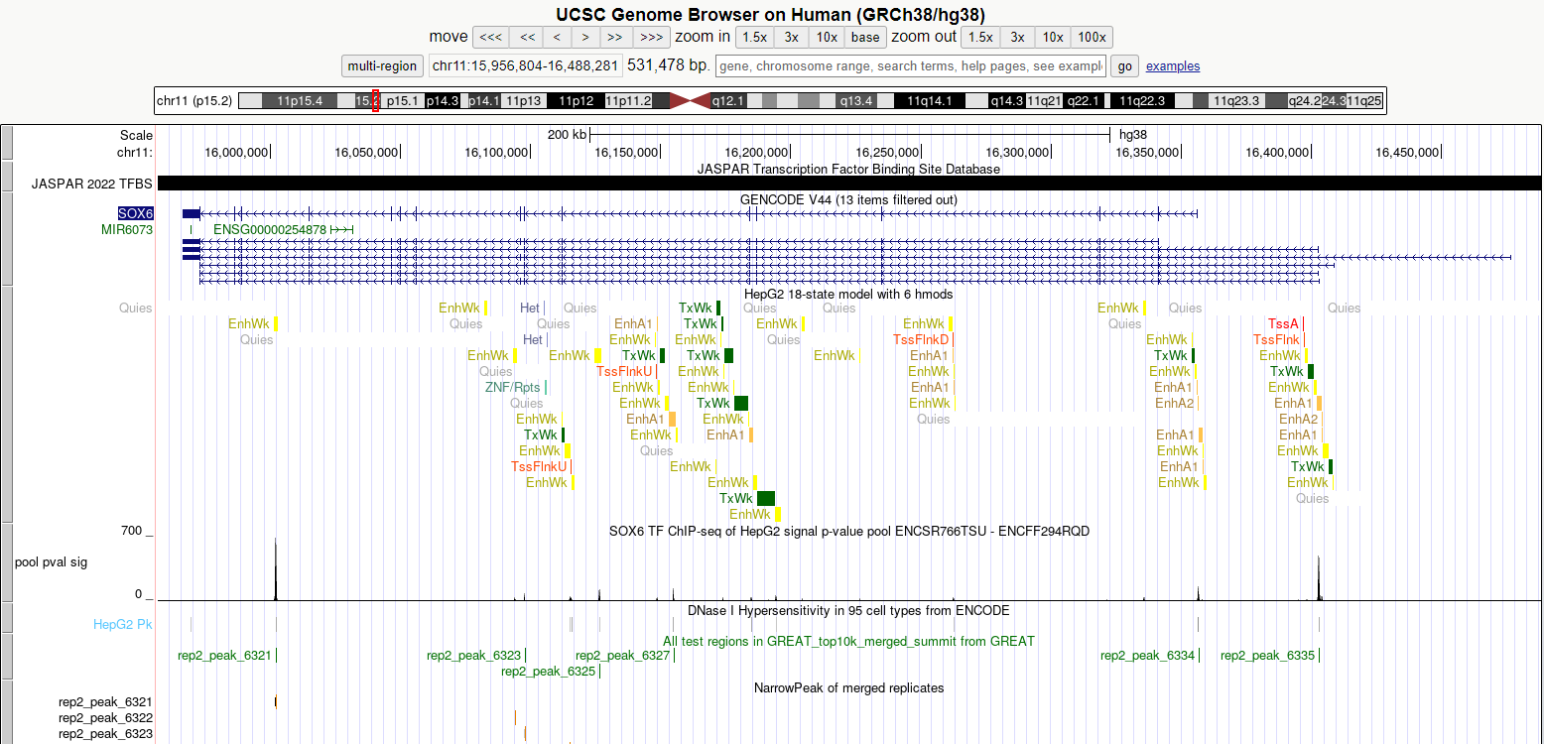

Whole SOX6
Notes:
HUUUUUGE gene, so we

Slide 13
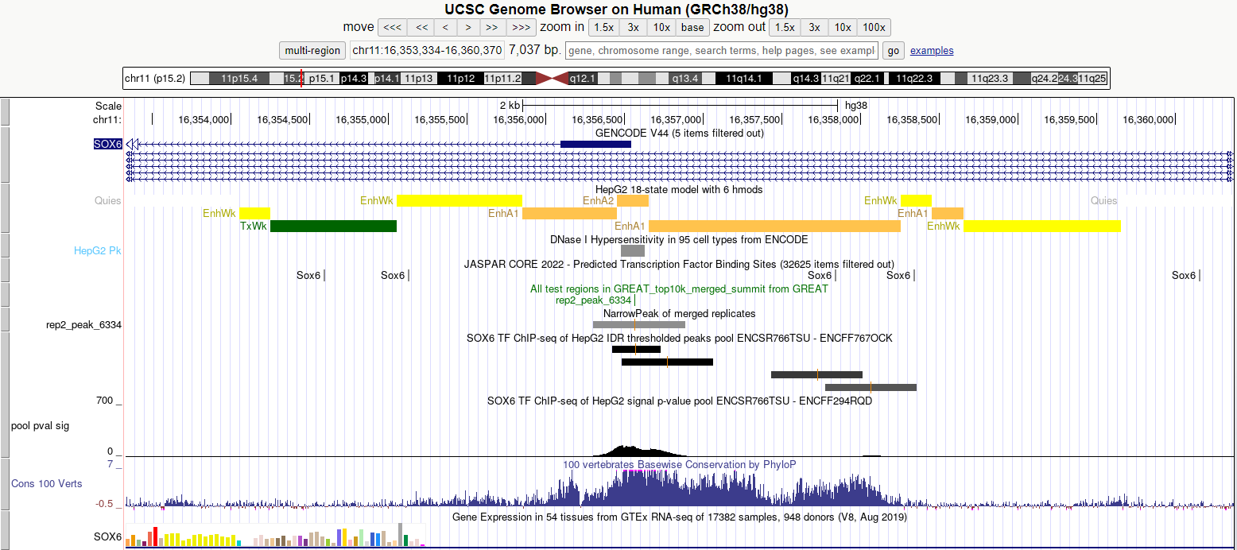
SOX6 TSS close-up

Slide 14
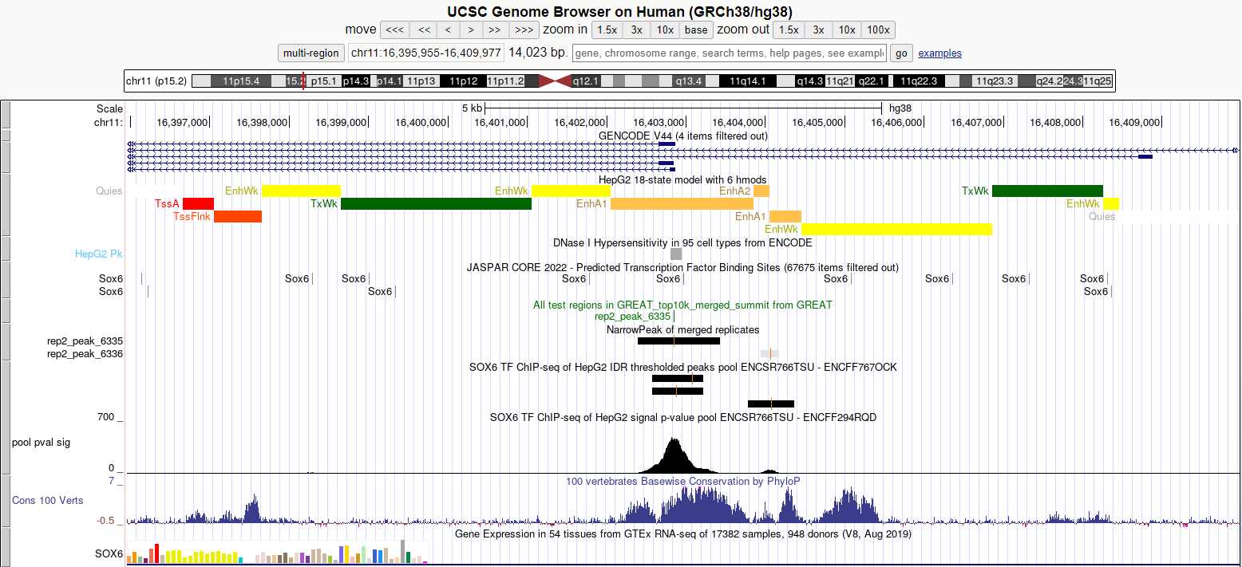
Alternative TSS close-up

Slide 15

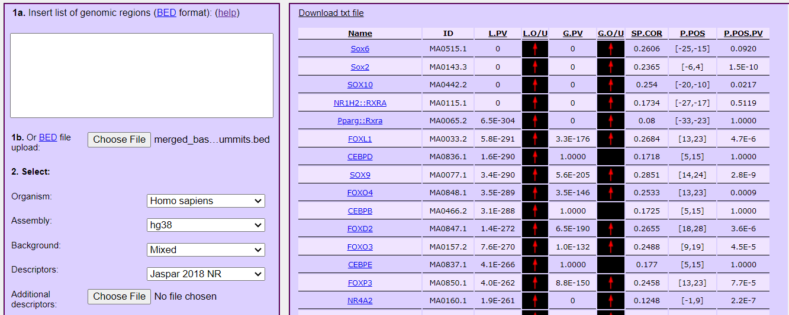
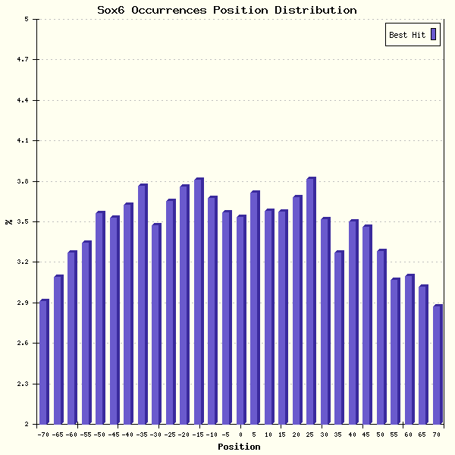
Motif enrichment
Notes:
L.Pv = if the matrix is over- or under-represented in the 150 bp input regions with respect to the genomic regions flanking them
g.Pv = if the matrix is over- or under-represented in the input regions with respect to a global background made of a genome-wide collection of putative regulatory
if the TF for which the ChIP was performed has its preferred binding site motif, then the corresponding matrix should present very low (usually, the lowest) p-values for global and local enrichment and positional bias
Other TFs which in general can be consider co-regulators with the IP'ed TF should present a low global p-value as well, meaning than they tend to bind the same regions of the main TF (e.g. the same promoters or enhancers), but not necessarily in very close proximity
TFs which may interact with the IP'ed TF should still present a low local p-value, meaning that when they happen to bind the same region, they tend to bind in the neighbourhood of the main TF, but not necessarily in every or most of the regions (for this you have to check the global p-value first); TFs which also present a positional bias (with low associated p-values) can be considered again interactors of the main TF, i.e., when they bind together with the main TF they require a precise arrangement of sites hinting at physical interaction, for example, they are members of the same TF complex, but this does not imply that it happens as a rule (check the global p-value or local p-values for this).
arrow (L.O/U) = indicates whether it means that the matrix motif tends to be over-represented in the sample (red arrow pointing upwards) or vice versa avoided (green arrow pointing downwards).
(since 2-sided t-test)
Positive sp.cor = the more enriched regions are, the best are motif matches in the region.

Slide 16
THANK YOU FOR YOUR ATTENTION

Slide 17
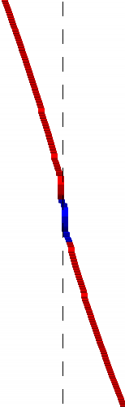
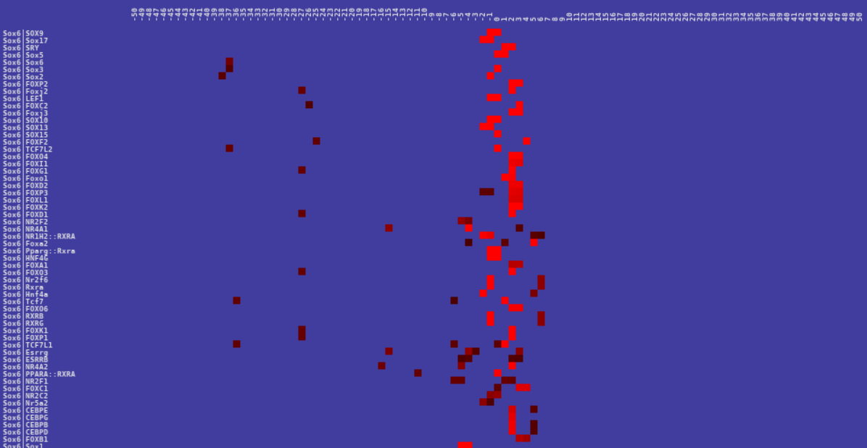
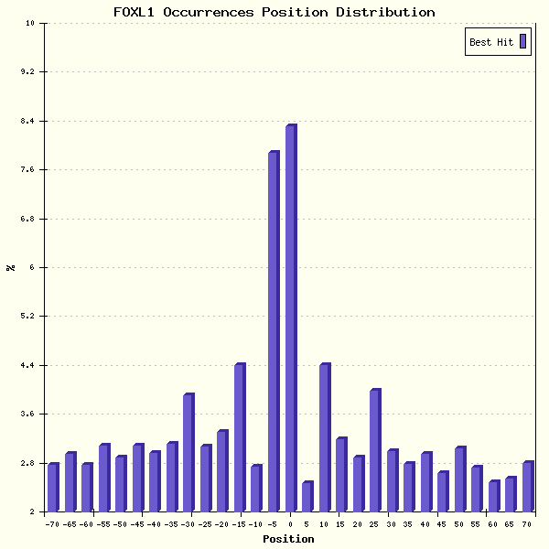
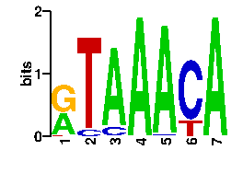
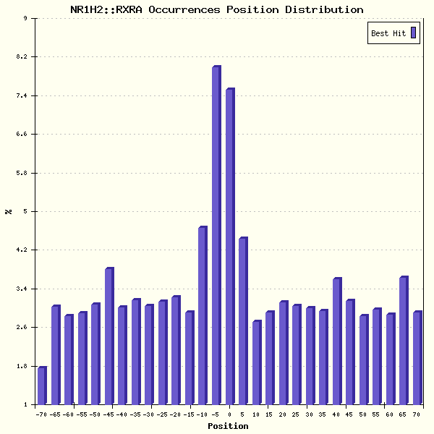
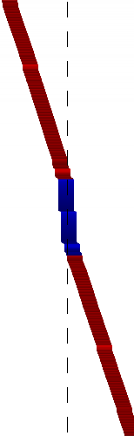
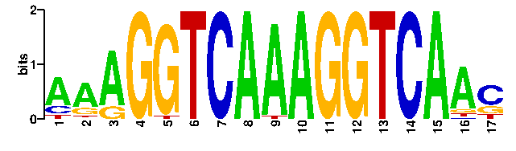
Motif-centered analysis
FOXL1 Fork head / winged helix factors domain
NR1H2::RXRA Nuclear receptors with C4 zinc fingers domain
Notes:
The rationale behind this kind of analysis is that, once the binding motif for the TF investigated has been detected, further information can be gathered by re-running the analysis centered on the motif itself, so to discover at a glance whether there exist any significant positional correlation between the motif chosen and the other TRANSFAC, JASPAR or user submitted matrices, and if the correlation is significant from a statistical point of view. In this way, additional candidate TFs binding in a cooperative way (e.g. forming heterodimers) can be discovered.

